Slide 1
Prediction of Gender of Foetus
By
Smart Predictors

Slide 2
OBJECTIVE:
The main objective of this project to predict the gender of foetus during the conceptive period itself.
Also to predict the gender between the pregnancy age of 45 – 55.
DATA SET:
For data set we used Chinese pregnancy calendar and created data set as per the calendar
In that calendar , with the help of month of conception and age when conceived , the gender of foetus can be predicted.
However There is no scientific claims behind it . Yet it gives 93 % of accuracy

Slide 3
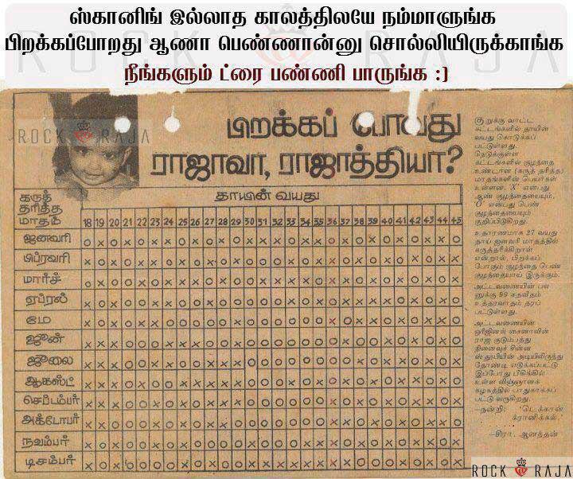
Fig depicting Chinese calendar

Slide 4
Now a days , many celebrities are giving birth to baby after 45 years of age and even over 50 years.
Ref:
https://en.wikipedia.org/wiki/Pregnancy_over_age_50
With the help of machine learning, we can predict the gender of foetus for such upper boundary values .
ACCURACY:
Till now we achieved accuracy of about 60 percent with random forest classifier and we are trying to improve that accuracy.

Slide 5
Legalised countries for PGD:
Though it Gender Determination is banned in many countries like India , Some counties such as USA , Mexico , Italy , Thailand etc..

